Slide 1
Information Meeting
2024

Slide 2
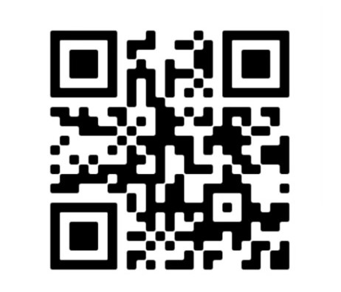
Calendar of Events for Lunar Rendezvous Festival Week Lunar Rendezvous Festival 2024 General Chair 2024: Elizabeth Olin GeneralChairman@lunarrendezvousfestival.org Week of 2024 Lunar Rendezvous Festival: July 14th-July 20th
www.LunarRendezvousFestival.org

Slide 3
Mission CONTROL
Clear Lake Lunar Rendezvous Festival is dedicated to providing community-based support including scholarships for higher education, youth development and educational programs, funding for the arts and historical preservation in the Bay Area Houston/NASA area.
What does this mean?
Service-oriented
Fundraising organization
Each year we do a distribution of funds, providing need-base scholarships, and support to other non-profit organizations. You are helping us fundraise for these causes!
At our big Kickoff in April, you will get to see our annual Distribution of Funds announced and see us present these funds to the non-profit organizations.

Slide 4
LRF Advisory Board
These individuals have served as General Chairs in the past and now serve as Liaisons to Committee Chairs and their individual events such as Dining Night, Fashion Show and Coronation Ball just to name a few. The festival would not be what it is each year without them!

Slide 5
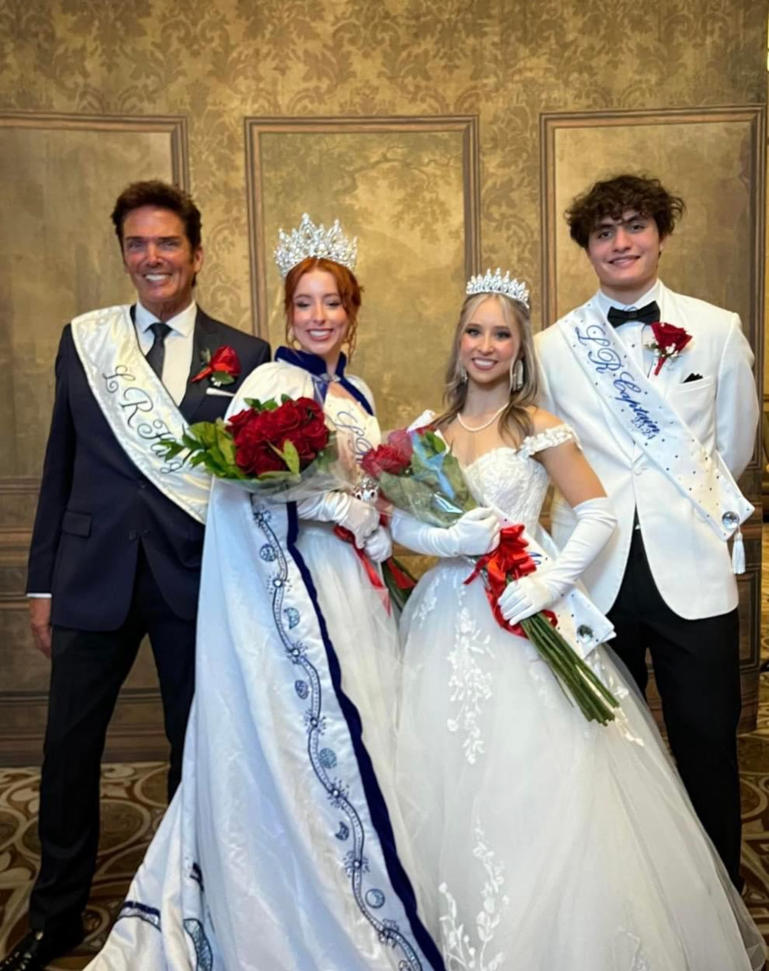
Royals
Royals Court Chair:
Marie Keener
2023-2024 Lunar Rendezvous Queen:
Savannah Bullock
2023-2024 Lunar Rendezvous Queen Alternate:
Katie Best
2023-2024 Lunar Rendezvous Lieutenant:
Sebastian Vivero
2023 Lunar Rendezvous King:
Lenny Matuszewski

Slide 6
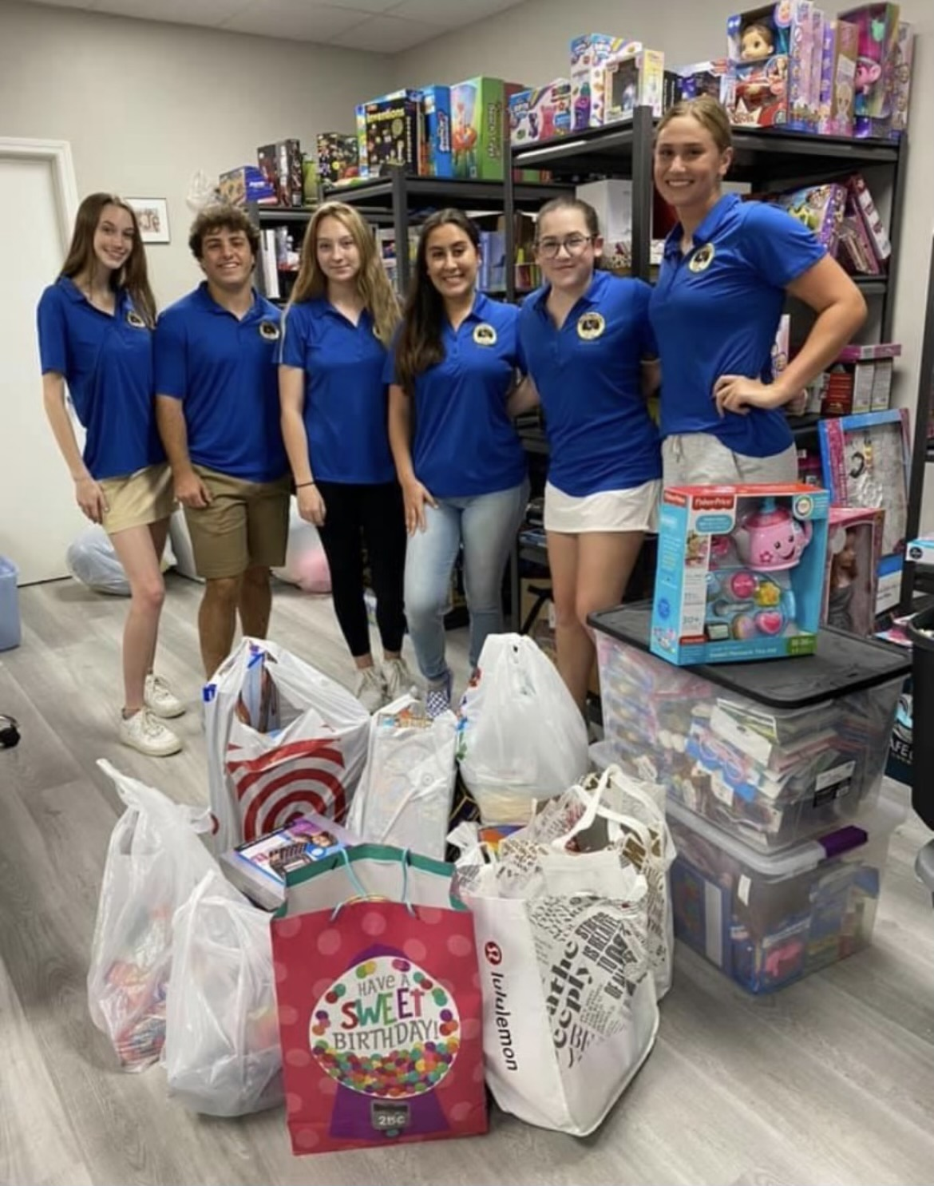
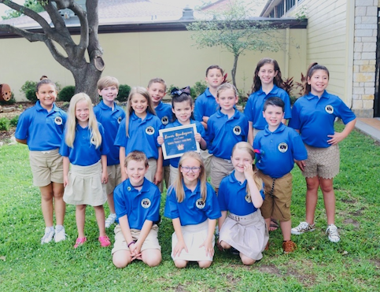
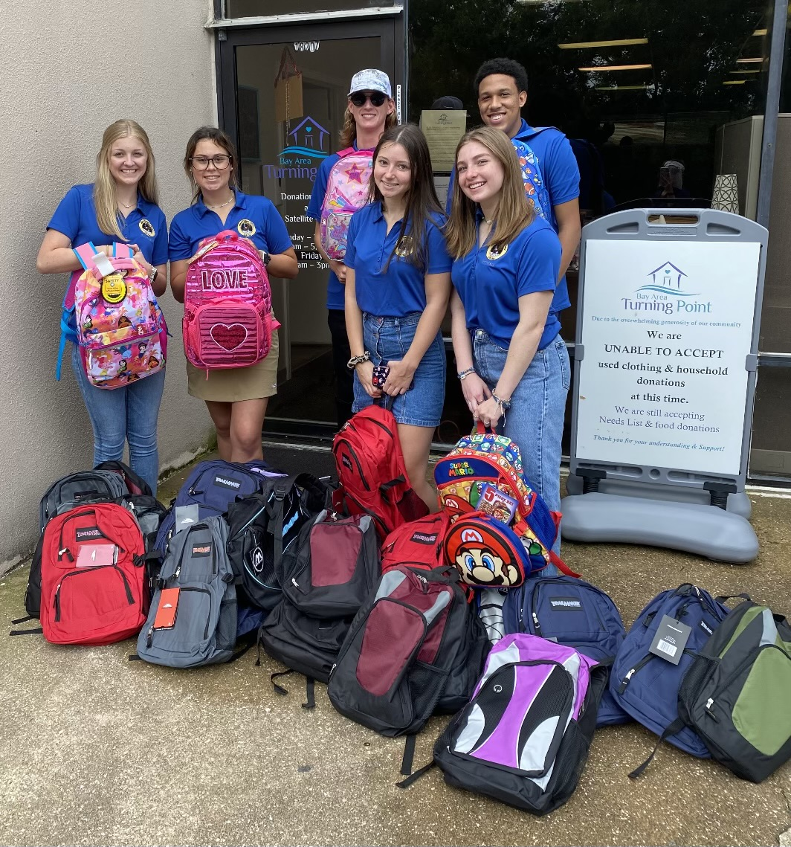
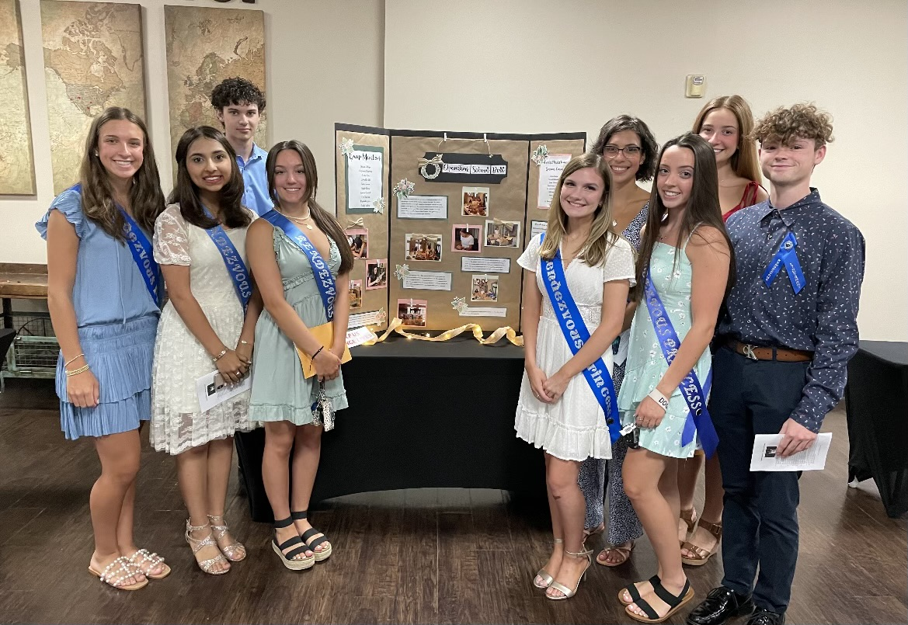
Court Chairs
Big Court Co-Chairs:
Jill Nagel Kaale & Joy Nagel
Little Court Chair:
Jill Aimes

Slide 7
2024 Festival Chairs
General Chair Elizabeth Olin
Vice Chair
Katie Jones
Administrative Assistant Kim Woods
Kickoff Chair Demerle Monks
Dining Night Co-Chairs Sara Taylor
Steffi Burks
Sunset Service Co-Chairs Allyson Biddy
Jennifer Robinson
Fashion Show Co-Chairs Cameron Cannon
Courtney Tylka
Coronation Ball Co-Chairs Melissa Tausend
Jayme Abshier
Auction Chair Kari Cook
Festival Big Court Co-Chairs Jill Nagel Kaale
Joy Nagel
Festival Little Court Chair Jill Aimes
Royal Court Chair Marie Keener
Corporate Sponsors Liaison Kim Woods
Raffle Co-Chairs Erin McDonald Scarlett Wood
Programs & Ads Chair Kathryn Holmes
Publicity Chair
Treasurer Lisa Holbrook

Slide 8
Important Upcoming Dates:
January 31, 2024 – Court application DEADLINE 11:59 p.m.
The $30 application fee MUST be paid upon submission of the application.
March 1, 2024 (on or around)
Applicants will be notified of Court selection. All applicants will be notified of outcome.
March 7, 2024 – Court Response Due
Acceptance FORM from the SELECTED applicants must be submitted online
$150 non-refundable Acceptance Fee
All other future dates will be covered in Court Orientation in April.

Slide 9
Court Mandatory Events
Orientation & Kick-Off-Party — Sunday, April 14th,12:00-3:30 p.m.
Sunset Service – Sunday, July 14th, 6:00 p.m.
Fashion Show Rehearsal – Monday, July 15th, 6:00-9:00 p.m.
Fashion Show – Tuesday, July 16th, 10:00a.m.
Coronation Ball Rehearsal – Thursday, July 18th, 5:00p.m.
Formal Group Photo – Thursday July 18th or Friday, July 19th, 7:00 a.m.
Coronation Ball – Saturday, July 20th

Slide 10
Expenses “What should I expect financially?”
Estimate of expenses, actual & potential, for MANDATORY events.
Court Application Fee (Big & Little) | $ 30
Court Acceptance Fee (Big & Little) | $150
Sunset Service | No tickets, just your personal attire expenses.
Fashion Show Ticket (Big Court & Royal Member) | Covered by Sponsor Fees
Fashion Show Tickets (Little Court & Family Member(s)) | $125 or $200 per person (general or runway seats)
Fashion Show Attire* (Court Member) | $200-$500 (*depends on your budget)
Fashion Show Attire* (Mother) | $200 (*depends on your budget)
Coronation Ball Ticket (Big Court & Royal Member and Escort) | Covered by Sponsor Fees
Coronation Ball Ticket (Little Court & Family Member(s)) | $175 per person (tables available as well)
Court Member Ball Attire* | $500-$1,000 (*depends on your budget)
Family Member Ball Attire* | $200-$300 (*depends on your budget

Slide 11
Acceptance: “I’ve been selected to the 2024 LRF Court, what now?”
Once contacted, if you are selected to serve on the 2024 Court, you must complete a Court Response Form, found on our website, under the Court tab.
ALL SELECTED Court members MUST complete the Court Response Form and either ACCEPT or DECLINE.
When you ACCEPT, you will pay a $150 Acceptance Fee*. What does that cover?
Big Court (Princesses/Lieutenants):
a. LRF polo shirt
b. Sash and sash pin for Princesses
c. Lapel pin for Lieutenants
d. Administrative fees
*Little Court (Little Ladies-in-Waiting/Pages):
LRF polo shirt
Sash and sash pin for Little Ladies-in-Waiting
Tiaras for Little Ladies-in-Waiting
White satin hand gloves for Little Ladies-in-Waiting
Lapel pin for Pages
Flowers presented at Coronation Ball
Administrative fees

Slide 12
Big Court & Royal Member Sponsor Requirement
Each Court Member must secure a sponsor for the 2024 season.
A Court Sponsor should be secured as soon as possible after notification of acceptance into the court.
A Court sponsor is not considered secured until the sponsorship fee has been paid online through the website.
Sponsors should be secured no later than April 30th, 2024
BIG COURT SPONSOR FEE $450:
Your fee covers:
-Court member’s ticket to the Fashion Show. -Court member and escort’s tickets to the Coronation Ball -Flowers presented at the Fashion Show and the Coronation Ball -Photography Sitting Fee (Formal Headshot)
ROYAL COURT SPONSOR FEE $575:
Your fee covers:
-Royal’s ticket to the Fashion Show. -Royal’s and escort’s tickets to the Coronation Ball -Flowers presented at the Fashion Show and Ball -Photography Sitting Fee (Formal Headshot) -Royal’s tiaras, sash, & polo -Parade entry fee

Slide 13
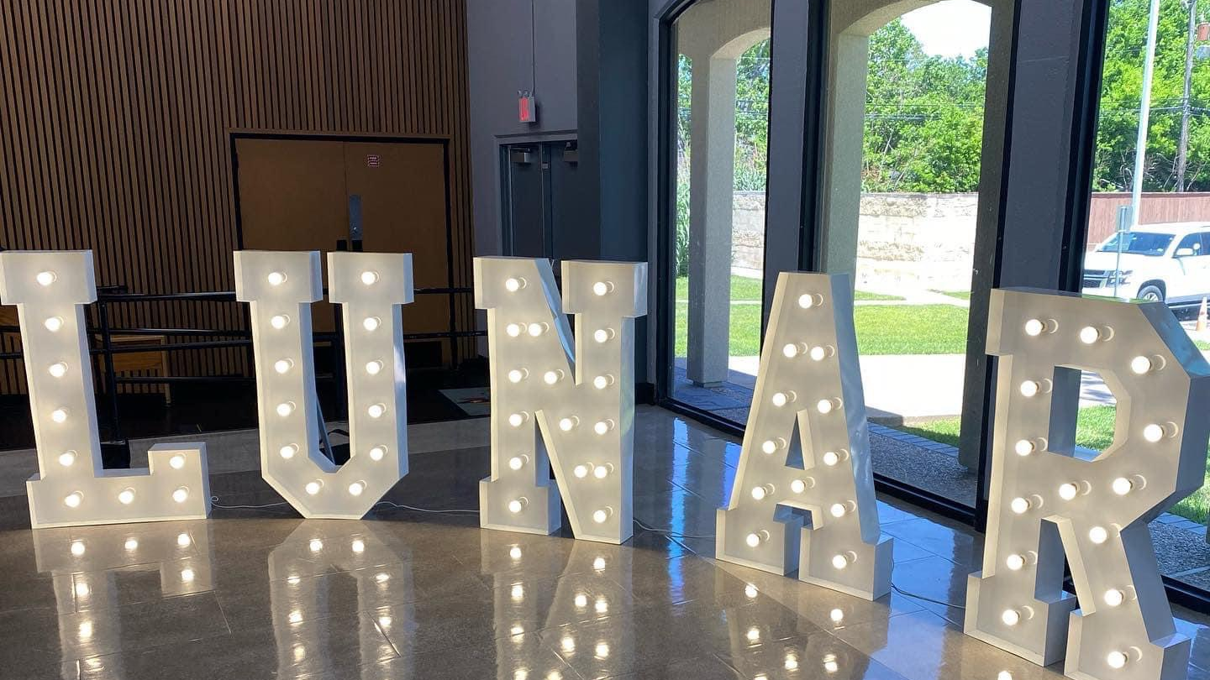
Questions?

