Slide 1
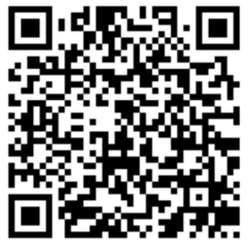
Information Meeting Please use the QR code to sign in: *Potential Big Court Members *Patents of Potential Little Court Members
2025

Slide 2
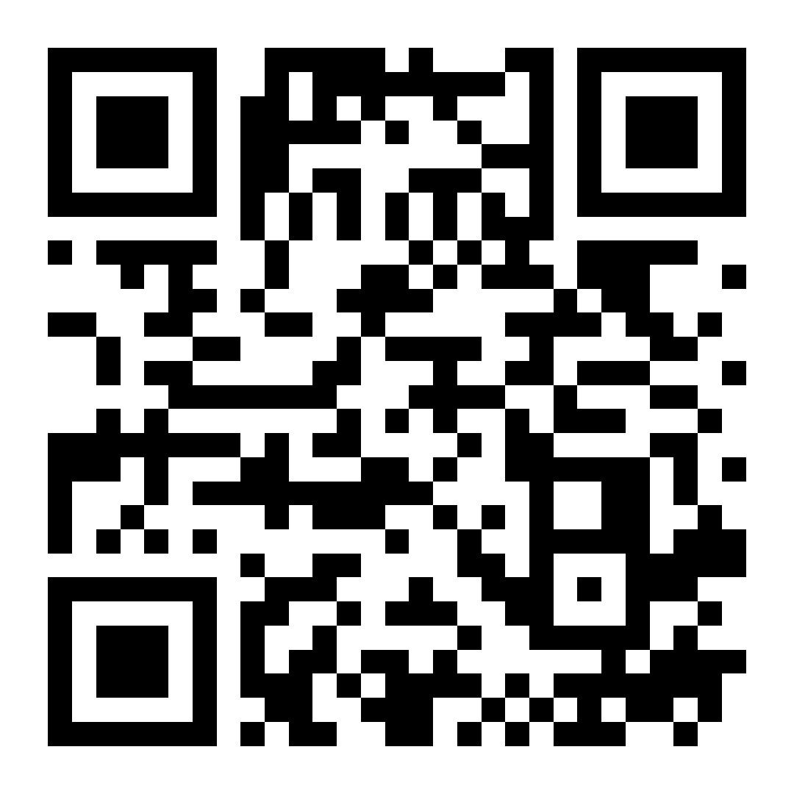
Calendar of Events for Lunar Rendezvous Festival Week Lunar Rendezvous Festival 2025 2025 General Chair: Katie Jones 2025 Vice-Chair: Kari Cook GeneralChairman@lunarrendezvousfestival.org 2025 Lunar Rendezvous Festival Week: July 13th-July19th
www.LunarRendezvousFestival.org

Slide 3
2025 General Chair Katie Jones
30 years of involvement with the Lunar Rendezvous Festival
Former Princess, volunteer, and event chair
2024 Vice-Chair
Mother of three court members
Lifelong volunteer, starting in 8th grade as an Assisteen
Active in PTA, Assistance League
Business owner supporting non-profits through event services
Wife and mother of four, inspiring family service and festival involvement

Slide 4
Mission CONTROL
Clear Lake Lunar Rendezvous Festival is dedicated to providing community-based support including scholarships for higher education, youth development and educational programs, funding for the arts and historical preservation in the Bay Area Houston/NASA area.
What does this mean?
We are a service-oriented and fund-raising organization! We focus on philanthropy, volunteerism, and giving back. Each year, we distribute funds, provide need-based scholarships, and provide community support to other non-profit organizations. You are helping us fundraise for these causes!
At our big Kick-Off in April, you will hear our annual Distribution of Funds grant recipients announced and see us present these funds to the non-profit organizations.

Slide 5
LRF Advisory Board
These individuals have served as General Chairs in the past and now serve as Liaisons to Committee Chairs and their individual events such as Dining Night, Fashion Show, and Coronation Ball just to name a few. The festival would not be what it is each year without them!

Slide 6
2025 Festival Chairs
General Chair Katie Jones
Vice-Chair
Kari Cook
Administrative Assistant Kim Woods
Kickoff Co-Chairs Cameron Cannon Scarlett Wood
Dining Night Co-Chairs Kristy Brown
Ann Wismer
Sunset Service Chair Demerle Monks
Fashion Show Chair Sarah Ferguson
Coronation Ball Co-Chairs Jayme Abshier Melissa Tausend
Auction Chair Sarah Carroll
Princess and Lieutenant Court Chair Renee Adams
Little Ladies-in-Waiting and Page Court Chair Amy Best
Royal Court Co-Chairs Marie Kenner
Jill Smitherman
Corporate Donor Sponsor Coordinator Kim Woods
Power Raffle Chair Meghan Bionat
Programs & Ads Chair Kathryn Holmes
Publicity Co-Chairs Jennifer Mason
Savannah Brieden
Treasurer Kelli Byrd

Slide 7
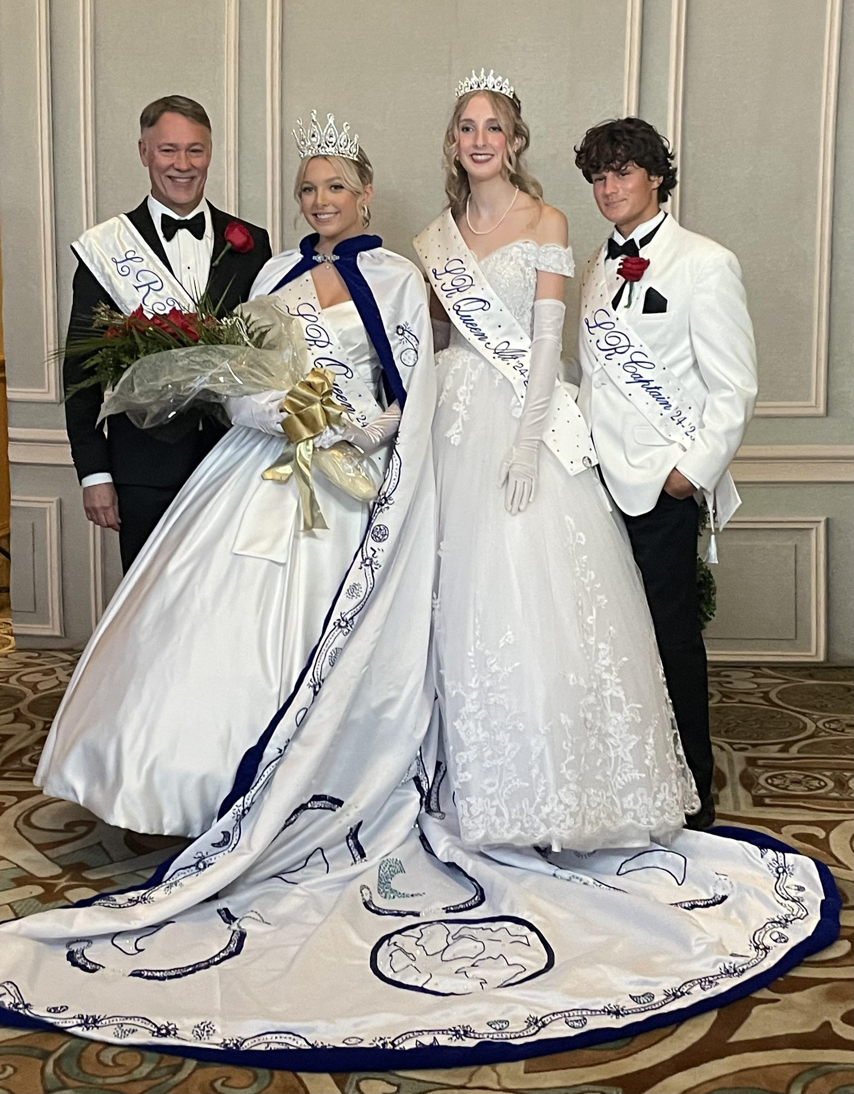
Royals
Royal Court Co-Chairs:
Marie Keener and Jill Smitherman
2024-2025 Lunar Rendezvous Queen:
Brie McDowell
2024-2025 Lunar Rendezvous Queen Alternate:
Ginny Steen
2024-2025 Lunar Rendezvous Lieutenant:
Jett Davis
2024 Lunar Rendezvous King:
Dr. J. Derek Tieken

Slide 8
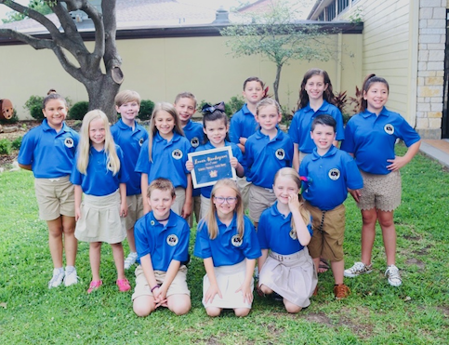
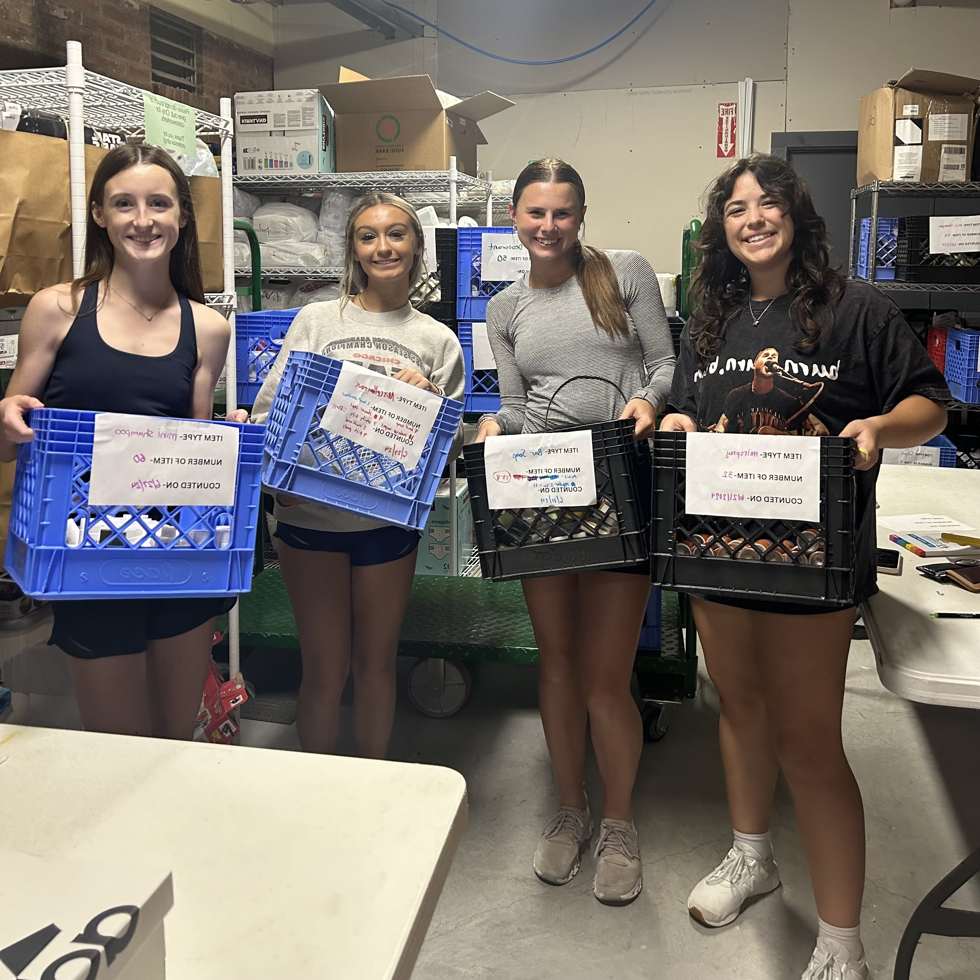
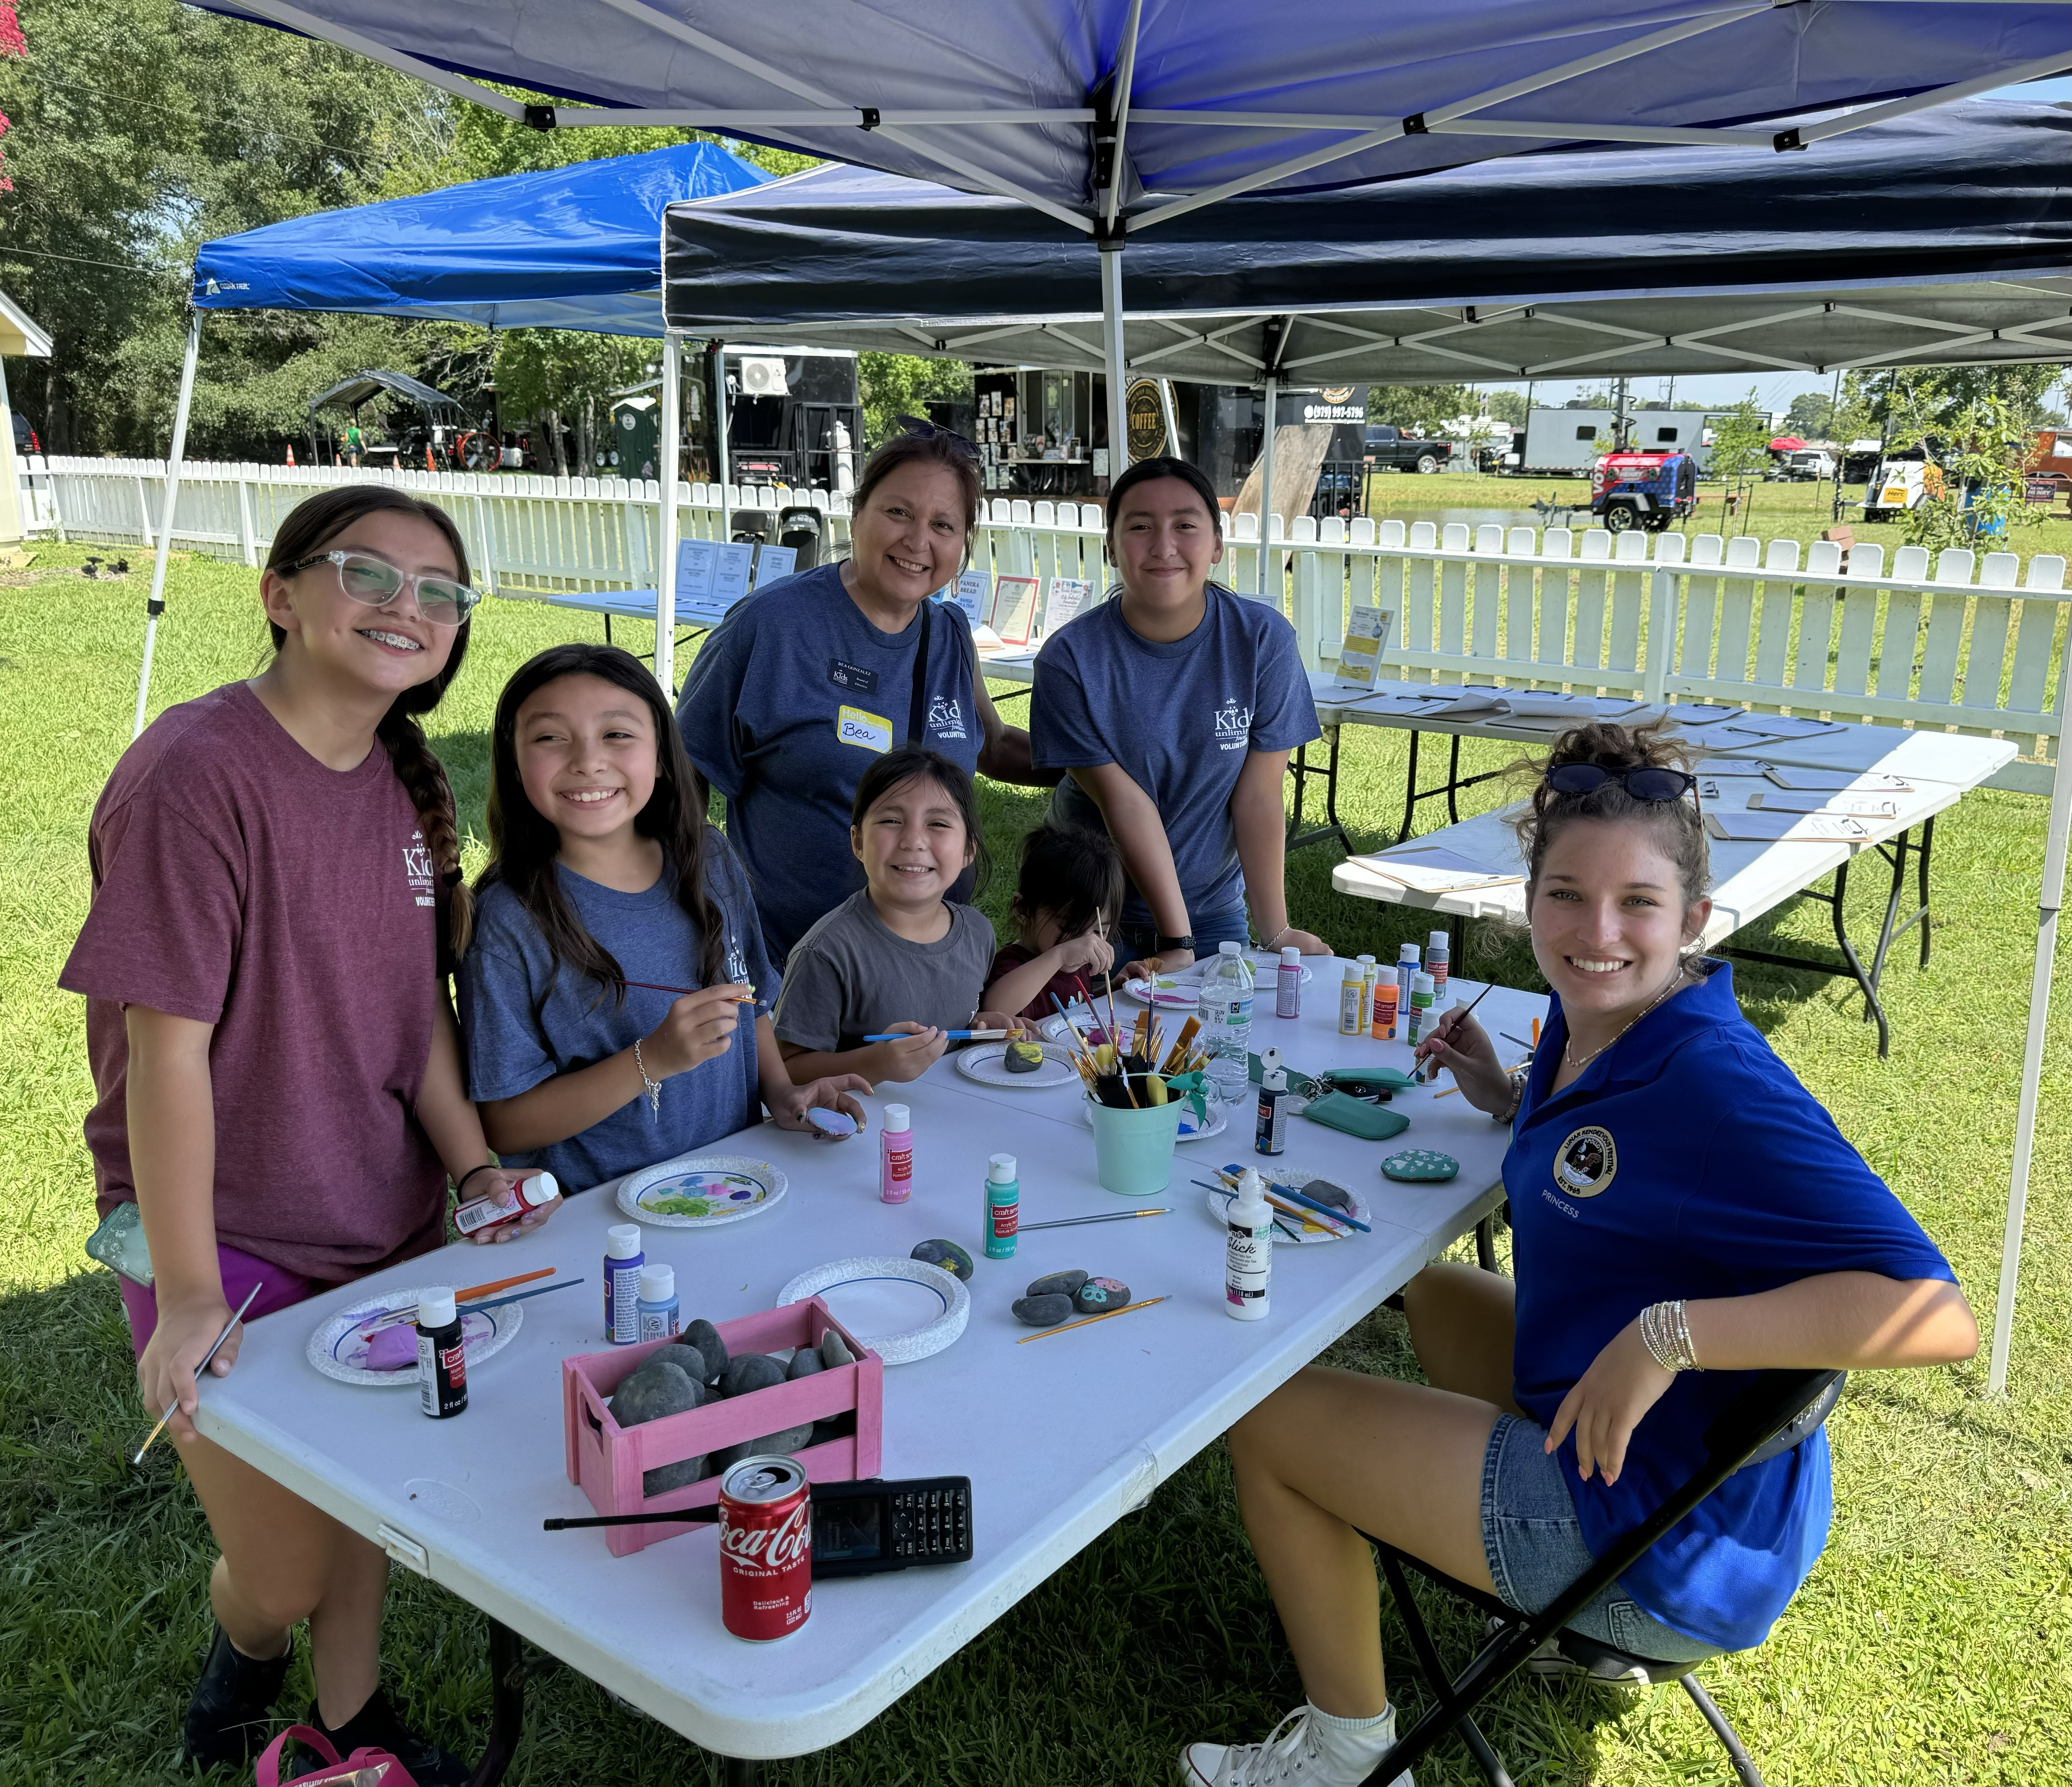
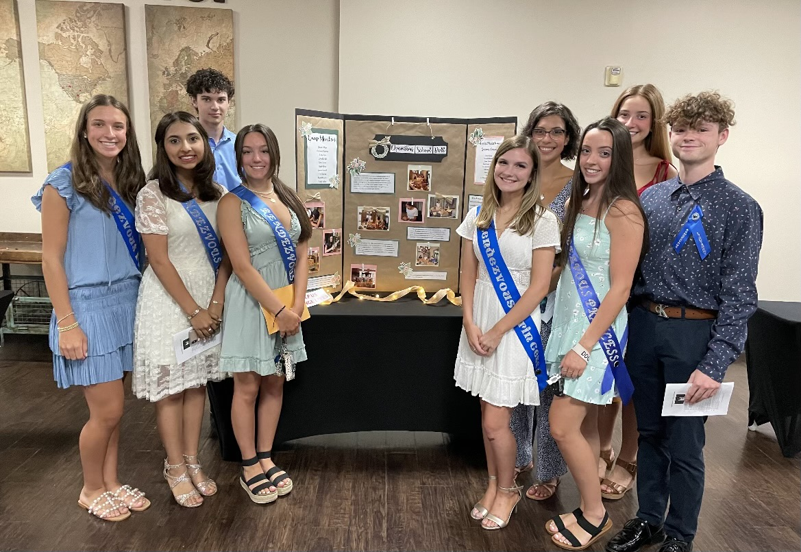
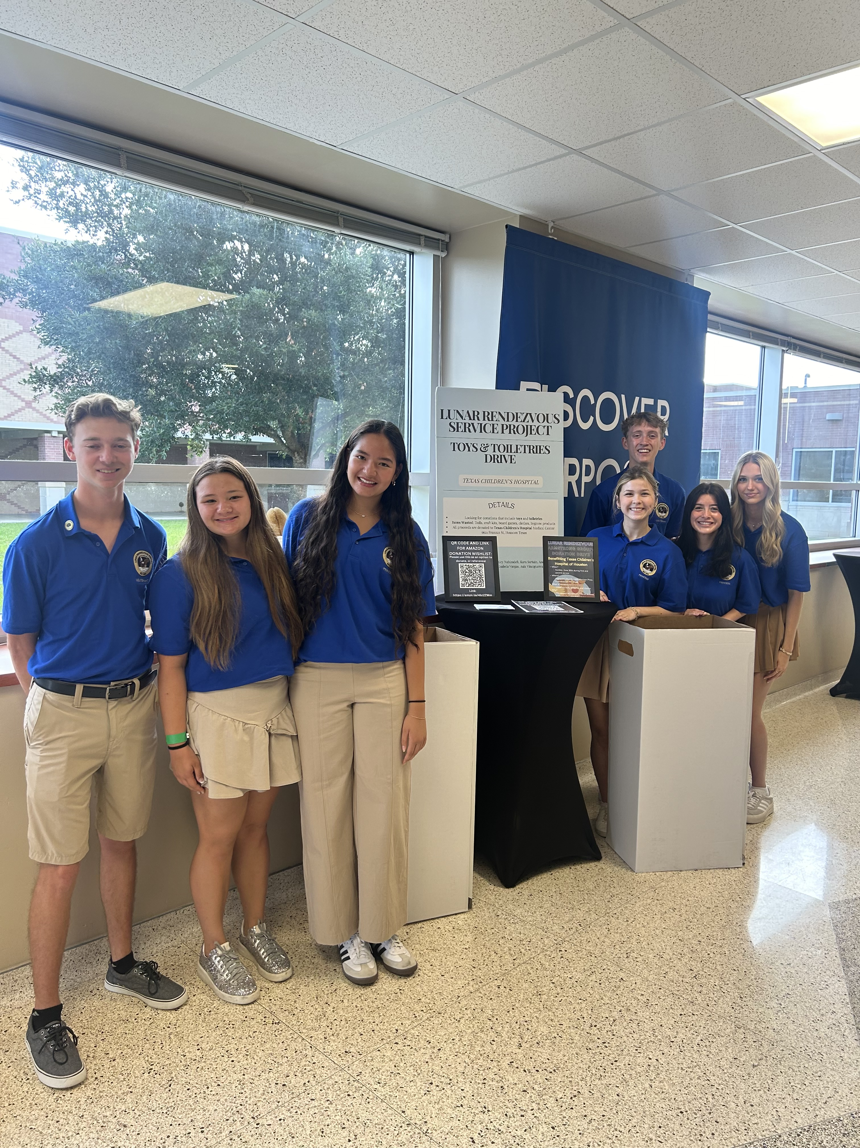
Court Chairs
Big Court Chair:
Renee Adams, Kathryn Stuart White
Little Court Chair:
Amy Best

Slide 9
Important Upcoming Dates:
January 31, 2025 – Court application DEADLINE 6:00 p.m. There will be no late applications accepted:
Application must be electronically submitted through our website.
Click on the COURT tab to find the online applications.
The $30 application fee MUST be paid upon the application submission.
March 1, 2025 (on or around) – Applicants will be notified of Court selection. All applicants will be notified of the outcome.
March 13, 2025 – Court Response Due: Signed Acceptance FORM from the SELECTED applicants must be submitted online by 6:00 p.m., and a $150 non-refundable Acceptance Fee is to be paid at that time.
All other future dates will be covered in Court Orientation in April.

Slide 10
Court Mandatory Events
Orientation & Kick-Off-Party, Sunday, April 6th,12:00-3:30 p.m. (MANDATORY)
Kick-Off Co-Chairs: Cameron Cannon/ Scarlett Wood
Sunset Service – Sunday, July 13th, 6:00 p.m. (MANDATORY)
Sunset Service is for all Courts, Lunar Team
Sunset Service Chair: Demerle Monks
Fashion Show Rehearsal – Monday, July 14th, 6:00-9:00 p.m. (MANDATORY)
Fashion Show rehearsal for Royals/King, Princesses, Lieutenants, Moms/Presenters, Little Ladies, and Pages.
Fashion Show Chair: Sarah Ferguson
Fashion Show – Tuesday, July 15th, 10:30 a.m. (call time will be earlier, please know this will take most of the day.) (MANDATORY)
Fashion Show for Royals/King, Little Court, Princesses, Lieutenants and Moms/Presenter
Coronation Ball Rehearsal – Thursday, July 17th, 5:00 p.m. (MANDATORY)
Coronation Ball Rehearsal for Royals/King, Princesses, Lieutenants, Presenters, & Escorts (Little Court will rehearse right before the ball, they are not needed this evening.)
Coronation Ball Chairs: Jayme Abshier/ Melissa Tausend
Formal Group Photo – Friday, July 18th, 8:00 a.m. (MANDATORY)
Official Formal Group Photograph for all Royals/King, Court Chairs, Ball Chairs, Princesses and Lieutenants, and Little Court
Coronation Ball – Saturday, July 19th (MANDATORY)
Coronation Ball is for Royals/King, Little Court, Princesses, Lieutenants, Presenters, & Escorts

Slide 11
Dress Code & Expenses “What should I expect financially?”
Estimate of expenses, actual & potential, for MANDATORY events.
Court Application Fee | $ 30
Court Acceptance Fee | $150
Sunset Service | No tickets, just your personal attire expenses.
Fashion Show Ticket (Court Member) | Covered by Sponsor Fees
Fashion Show Tickets (Other family/friends) | $125-$200 per person (depends on seat)
Fashion Show Attire* (Court Member) | $200-$500 (*depends on your budget)
Fashion Show Attire* (Mother) | $200 (*depends on your budget)
Coronation Ball Ticket (Court Member) | Covered by Sponsor Fees
Coronation Ball Ticket (Other family/friends) | $175 per person (tables available as well)
Court Member (Princess) Ball Attire* Ball Gown | $500 and up (*depends on your budget)
Court Member (Lieutenant) Ball Attire* Tuxedo | $150 and up
Family Member Ball Attire* Black Tie | $200-$500 (*depends on your budget

Slide 12
Acceptances: “I’ve been selected to the 2025 LRF Court, what now?”
Once contacted, if you are selected to serve on the 2025 Court, you must complete a Court Response Form, found on our website, under the Court tab.
ALL SELECTED Court members MUST complete the Court Response Form and either ACCEPT or DECLINE.
When you ACCEPT, you will pay a non-refundable $150 Acceptance Fee*. What does that cover?
Big Court (Princesses/Lieutenants):
a. LRF Polo shirt
b. Sash and sash pin for Princesses
c. Lapel pin for Lieutenants
d. Administrative fees
*Little Court (Little Ladies-in-Waiting/Pages):
a. LRF shirt
b. Sash and sash pin for Little Ladies-in-Waiting
c. Tiaras for Little Ladies-in-Waiting
d. Lapel pin for Pages
e. White satin hand gloves
f. Presentation flowers for coronation ball
Professional head shot fee for formal portraits
Administrative fees
In addition, as a Court Member, you will be asked to solicit auction items and sell 10 raffle tickets, if a standard raffle is held. This will be one way you are helping to fundraise for scholarships and to support non-profits, our MISSION!

Slide 13
Court Member Sponsor Requirement
Each Court Member must secure a sponsor for the 2025 season.
A Court Sponsor should be secured as soon as possible after notification of acceptance into the court.
A Court Sponsor is not considered secured until the sponsorship fee has been paid online through the website.
Sponsors should be secured no later than April 30th, 2025
NON-REFUNDABLE BIG COURT SPONSOR FEE $450:
Your fee covers:
-Court member’s ticket to the Fashion Show. -Court member and escort’s tickets to the Coronation Ball -Flowers presented at the Fashion Show and the Coronation Ball -Photography Sitting Fee (Formal Headshot)
NON-REFUNDABLE ROYAL COURT SPONSOR FEE $575:
Your fee covers:
-Royal’s ticket to the Fashion Show. -Royal’s and escort’s tickets to the Coronation Ball -Flowers presented at the Fashion Show and Ball -Photography Sitting Fee (Formal Headshot) -Royal’s tiaras, sash, & polo -Parade entry fees

Slide 14
Thank you for attending the 2025 Lunar Rendezvous Court Information Meeting!
Questions?

